Slide 1
Software engineering
Project Scheduling
By Sandia Kumari

Slide 2
Scheduling
Scheduling of a software project does not differ greatly from scheduling of any multitask engineering effort. Therefore, generalized project scheduling tools and techniques can be applied with little modification for software projects.
Program evaluation and review technique (PERT) and the critical path method (CPM) are two project scheduling methods that can be applied to software development. Both techniques are driven by information already developed in earlier project planning activities: estimates of effort, a decomposition of the product function, the selection of the appropriate process model and task set, and decomposition of the tasks that are selected.

Slide 3
Scheduling
Interdependencies among tasks may be defined using a task network. Tasks sometimes called the project work breakdown structure (WBS), are defined for the product as a whole or for individual functions.
Both PERT and CPM provide quantitative tools that allow you to (1) determine the
critical path—the chain of tasks that determines the duration of the project, (2) establish
“most likely” time estimates for individual tasks by applying statistical models, and
(3) calculate “boundary times” that define a time “window” for a particular task.

Slide 4
Time-Line Charts
When creating a software project schedule, you begin with a set of tasks (the work breakdown structure). If automated tools are used, the work breakdown is input as task network or task outline. Effort, duration, and start date are then input for each task. In addition, tasks may be assigned to specific individuals.
As a consequence of this input, a time-line chart, also called a Gantt chart, is generated. A time-line chart can be developed for the entire project. Alternatively, separate charts can be developed for each project function or for each individual working on the project

Slide 5
Gantt Basics
Basically, a timeline with tasks that can be connected to each other
Can be created with simple tools like Excel, but specialised tools like Microsoft Project make life easier

Slide 6
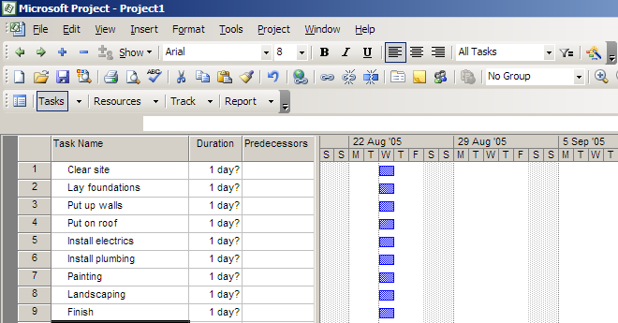
Making a Gantt chart
Step 1 – list the tasks in the project

Slide 7
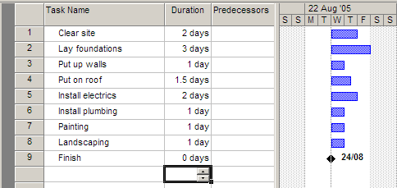
Making a Gantt chart
Step 2 – add task durations

Slide 8
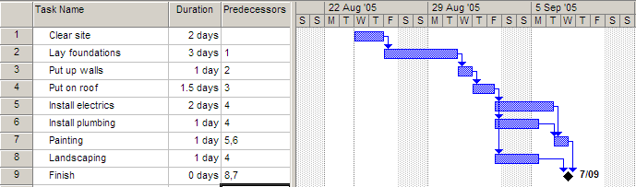
Making a Gantt chart
Step 3 – add dependencies (which tasks cannot start before another task finishes)

Slide 9
Notes
The arrows indicate dependencies.
Task 1 is a predecessor of task 2 – i.e. task 2 cannot start before task 1 ends.
Task 3 is dependent on task 2. Task 7 is dependent on two other tasks
Electrics, plumbing and landscaping (5,6,8) are concurrent tasks and can happen at the same time, so they overlap on the chart. All 3 can start after task 4 ends.
Painting must wait for both electrics and plumbing to be finished.
Task 9 has zero duration, and is a milestone

Slide 10
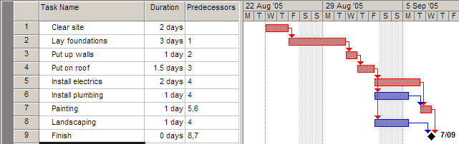
Making a Gantt chart
Step 4 – find the critical path
The critical path is the sequence of tasks from beginning to end that takes the longest time to complete.
It is also the shortest possible time that the project can be finished in.
Any task on the critical path is called a critical task.
No critical task can have its duration changed without affecting the end date of the project.

Slide 11
MS Project can work out the critical path for you!
The length of the critical path is the sum of the lengths of all critical tasks (the red tasks 1,2,3,4,5,7) which is 2+3+1+1.5+2+1 = 10.5 days.
In other words, the minimum amount of time required to get all tasks completed is 10.5 days
The other tasks (6,8) can each run over-time before affecting the end date of the project

Slide 12
The amount of time a task can be extended before it affects other tasks is called slack (or float).
Task 6 can take an extra day and a half before it affects the project’s end date, so each has 1.5 day’s slack.
Notes:
Float = Late Start – Early Start OR Late Finish – Early Finish

Slide 13
Critical tasks, by definition, can have NO slack.
Thus if you are ever asked, “Can the duration of a critical task be changed without affecting the end date of the project?”, the answer is always NO!

Slide 14
PERT basics
PERT is an acronym so it’s in capital letters (Program evaluation and review technique)
Gantt is a name, so only has an initial capital
In Gantt chart, the length of a task’s bar is proportional to the length of the task. This rarely applies to PERT charts.
There are a few different “flavours” of PERT and Gantt charts…

Slide 15
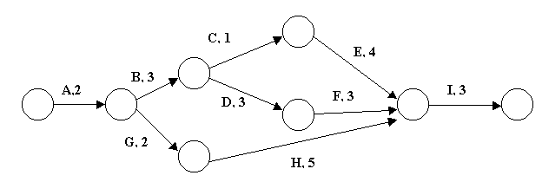
PERT charts
This PERT chart follows the “Activity on Arrow” style.
The tasks are shown by arrows. Task name are shown by letters, in this case.
The circles are called nodes. The nodes indicate the start or end of tasks.
Task durations are the shown by the numbers.

Slide 16
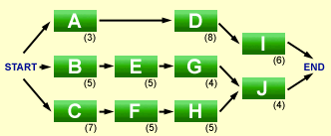
‘Activity on Node’ style PERT
Activity on Node is a different flavour of PERT: this time the nodes are tasks, and the arrows are merely connectors. We will use Activity on Arrows, with the nodes merely connecting points.

Slide 17
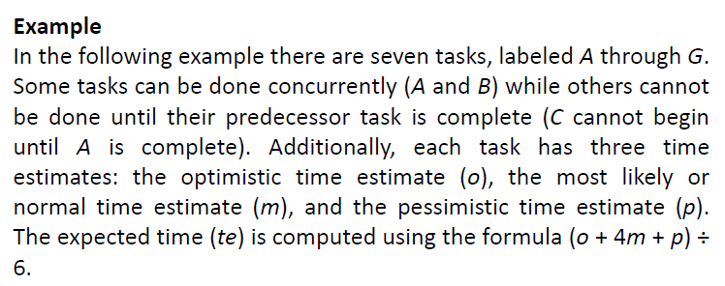

Slide 18
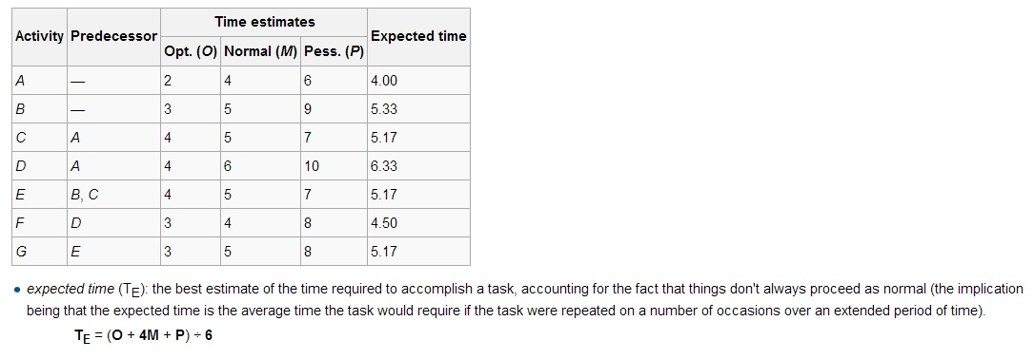
Sidebar…

Slide 19
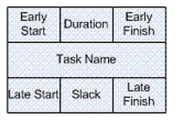
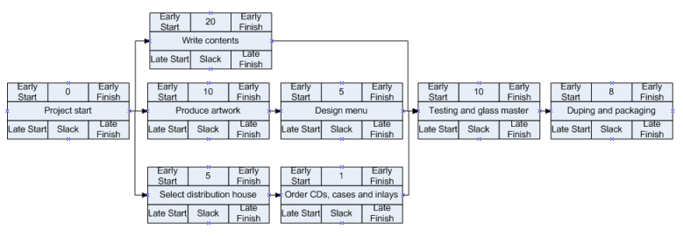

Slide 20
Early Start – The earliest time that an activity can start providing no changes to the schedule
Early Finish – The earliest time that an activity can finish providing no changes to the schedule
Late Start – The latest time that an activity can start without increasing the duration of the project
Late Finish – The latest time that an activity can finish without delaying the end date of the project
Notes:
Early start (ES)= providing no changes to schedules no delays

Slide 21
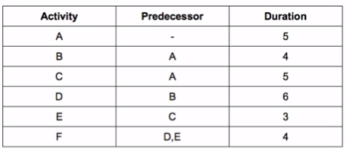

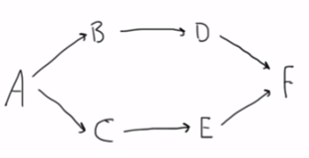
Example: Activity Network
Critical Path
The critical path is the sequence of activities with the longest
duration. A delay in any of these activities will result in a delay for
the whole project
Notes:
Activity A is 5 days long

Slide 22

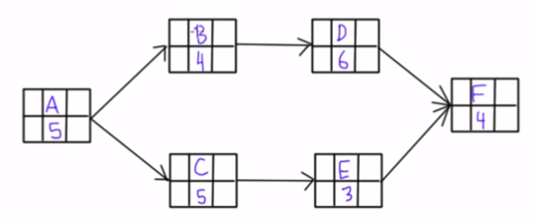
Example: Activity Network

Slide 23
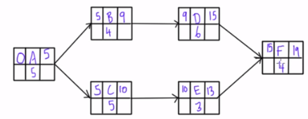
Example: Activity Network- Early Start and Early finish (Forward Pass)
A,B,D,F = 5+4+6+4=19
A,C,E,F= 5+5+3+4= 17
Therefore, ABDF is critical path
Notes:
Start activity has no predecessor so 0 ES>EF of predecessor
Forwa

Slide 24

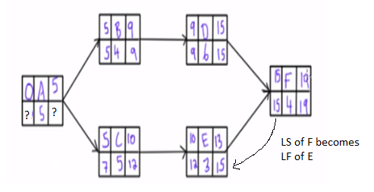
Example: Activity Network- Late Start and Late finish
Notes:
LF-duration= LS
19-4=15
15-3=12

Slide 25

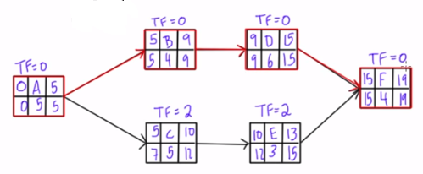
Example: Activity Network- Total Float(Slack)
Total float is how long an activity can be delayed, without delaying the project completion date. On a critical path, the total float is zero.
Total Float=TF
TF=LS-ES OR TF=LF-EF

Slide 26


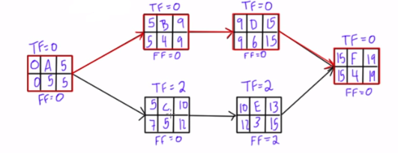
Example: Activity Network- Free Float(Slack)
Free float is how long an activity can be delayed, without delaying the Early Start of its successor activity.
Or FF= ES(successor) – EF (activity)
Notes:
As Activity F has no successor activity so FF would be equal to total float
5-0-5=0

Slide 27
Some terminologies
Buffer also referred to as Schedule Margin, Schedule Buffer, Contingency, Reserve, etc... is an activity or period of time that is strategically placed on the Critical Path, typically prior to the agreed upon completion or delivery date.
Lead
The amount of time whereby a successor activity can be advanced with respect to a predecessor activity.
Lag
The amount of time whereby a successor activity is required to be delayed with respect to a predecessor activity.

